Slide 1
Welcome!
Please, have a seat.
CWRU Quants
quants@case.edu
Notes:
Christo

Slide 2
Agenda
What is backtesting?
The Don’ts of Backtesting
The Dos of Backtesting
The Backtesting Project
Break into Project Groups
Notes:
Christo

Slide 3
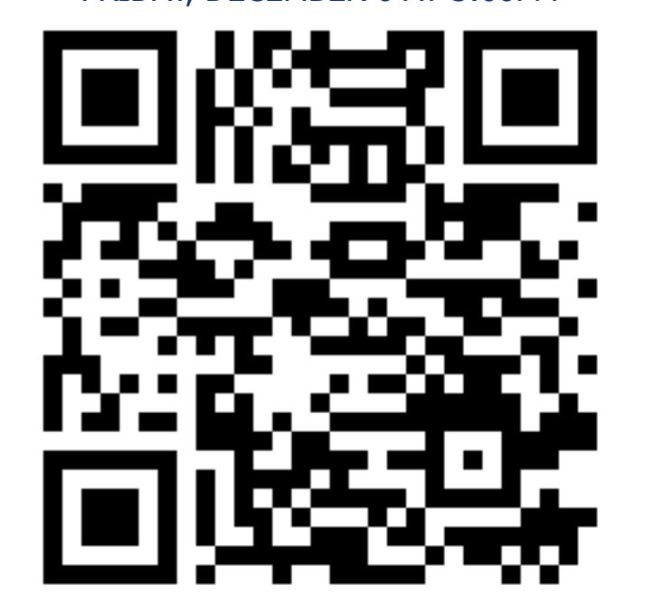
Attendance | CampusGroups
Notes:
Christo

Slide 4

Discord (important!)
Notes:
Christo

Slide 5
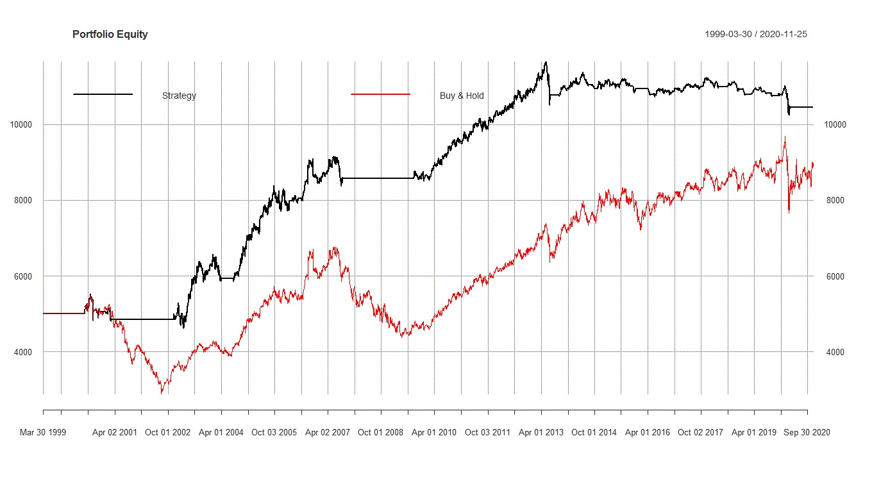
Backtesting
Notes:
Christo

Slide 6
What is backtesting?
The idea is simple – after a strategy has been developed, test its performance on historical data against a benchmark.
What do we mean by “strategy”? It is a very broad term. It can mean:
buying and holding an asset
buying and selling an asset based on a signal
holding a basket of assets and periodically rebalancing
shorting an asset
any combination of the above strategies, but with an asset and its derivatives
trading based on the output of a high-frequency trading algorithm
exploiting any form of risk premium (equity, variance, credit risk, etc)
and more
Notes:
Christo

Slide 7
More on Backtesting
How do we measure “performance”? Again, several ways, including:
raw rate of return (over any time period, but usually CAGR is used)
Sharpe/Sortino ratio (rate of return adjusted for standard deviation of returns
max drawdown (even if a strategy outperforms in returns, a 95% drawdown is never good, for example)
Ulcer Index (a measure of downside volatility)
correlation to benchmark (it is often beneficial to have uncorrelated assets in a portfolio for diversification)
Notes:
Christo

Slide 8
Even More on Backtesting
What benchmarks are used? Usually, one of the following:
The risk-free rate. Used as a bare minimum, failure to clear this bar is grounds for immediate disqualification, but clearing it could be a sign that further analysis is warranted.
An index. This is by far the most common, as buying and holding an index fund is a relatively safe and very easy way to beat the risk-free rate and make an at least decent return.
An asset. Similar reasons to an index, except some derivatives or HFT strategies carried out on one asset specifically might be better compared to the idiosyncrasies of the price action of the asset itself than an unrelated index.
Notes:
Christo

Slide 9
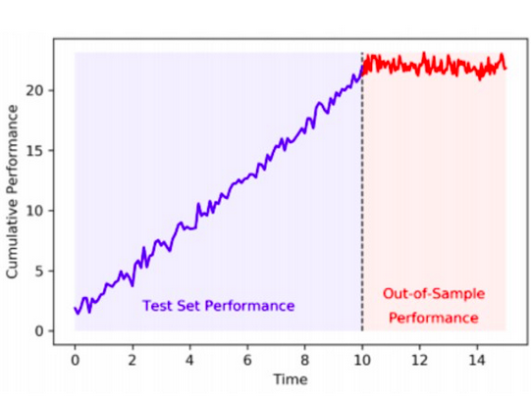
The Don’ts of Backtesting
Notes:
Transition

Slide 10
Look-Ahead Bias
Without access to high frequency date (i.e. data indexed by minute or day) it is difficult to accurately implement a signal when it is observed
When using historical data, you must assume that the signal is observed at the latest possible time
In our case (monthly returns) we will lag the signal by one month and apply it to the next month
Buy today, look at the return tomorrow
Don’t use today’s return because trading is already done—as if you’re assuming you observe the ratio at 4 PM but you’re acting like you bought it at 9AM
Notes:
Christo

Slide 11
Sample Selection Bias
This bias comes from choosing non-random data for analysis – in this case, choosing arbitrary time periods slanted toward your strategy, the most favorable assets to trade, etc.
An example would be testing a strategy that is sensitive to long-term Treasury yields on only the periods from 1990-2020: treasury yields only went down during that period.
This can also include aspects of look-ahead bias
For example, if you looked at the top performing stocks of the month and trade based on some common attribute they had (for ex. an earnings beat the last month)
This would be an example of look-ahead bias since you’re only looking at stocks you know from hindsight performed well and had that attribute, and not the ones that performed poorly
It would also be sample selection bias since the data isn’t random (you explicitly looked for the best performing stocks)

Slide 12
It’s for validation purposes only
A major pitfall of backtesting is the trap of trying to adjust a strategy to garner the highest possible returns on historical data.
Similarly, trying to throw multiple unrelated strategies at the same set of data is also a recipe for failure.
Markets are real-time phenomena with extremely low signal-to-noise ratio. This means that a strategy’s outperformance in one time interval has very little predictive power of its over or underperformance in another interval.
The low signal to noise ratio is the root of the above two issues, along another familiar issue…
Notes:
tom
https://www.davidhbailey.com/dhbpapers/overfit-tools-at.pdf

Slide 13
An example of our mystery issue
Here’s an example from Bailey et al. that illustrates the issue:
Suppose that a new compound XYZ is developed to treat headaches.
We wish to test for the hypothesis that XYZ is actually effective.
A false positive occurs when we falsely determine that XYZ has been effective. This can occur for a variety of reasons: the patient was misdiagnosed, the pain associated with headache oscillated closely to the threshold level to declare the condition, etc.
Suppose we use significance level of a=0.05, then the probability of a false positive is 5%.
We could test variations of the compound by changing an irrelevant characteristic (the color, the taste, the shape of the pill), and it is expected that at least 1 in 20 of those variations will be (falsely) declared effective.
The problem does not lie with biology or the complexity of the compound.
Instead, the researcher has conducted multiple tests while treating each individually, not realizing that in doing so she has incurred in an increasing probability of false positives.
Notes:
Tom
https://www.davidhbailey.com/dhbpapers/overfit-tools-at.pdf

Slide 14
Overfitting
The example illustrates the dangers of overfitting. The compound that passes the test does not pass on the basis of its efficacy, but rather based on whichever silly pseudorandom factors lead to the 5% false positive rate.
In mathematical finance, backtest overfitting refers to the usage of historical market data to develop an investment strategy, where many variations of the strategy are tried on the same dataset. (Bailey et. al)
Similarly to overfitting in machine learning, a trading strategy that is overfit to a dataset picks up the idiosyncrasies of the historical data it was “trained” on instead of behaviors that generalize across all time intervals.
Another flaw in approach that leads to an overfit strategy is modifying the strategy to perform better in backtests. Changing a strategy purely to produce better returns over the past 5 years makes no meaningful progress in developing a strategy that performs better over the next 5.
Notes:
Tom
https://www.davidhbailey.com/dhbpapers/overfit-tools-at.pdf

Slide 15
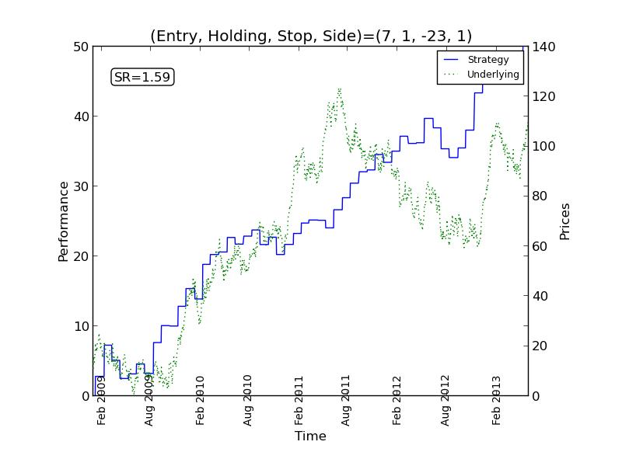
What do overfit trading strategies look like?
In the chart to the right, the green line represents the price action of the underlying, while the blue line represents the return of the strategy.
As you can see, the strategy makes consistent profit while the underlying asset gyrates randomly in price.
And yes, the asset price gyrations are, for all intents and purposes, random. Since price fluctuations have a low signal-to-noise ratio, you can’t say for sure that this is a real stock or the output of a Brownian motion simulation.
It is guaranteed that there is a trading strategy on this asset that outperforms it over this interval. In fact, it is guaranteed that there is a strategy that outperforms any asset over any finite time interval.
Notes:
Ethan
https://carmamaths.org/resources/backtest/

Slide 16
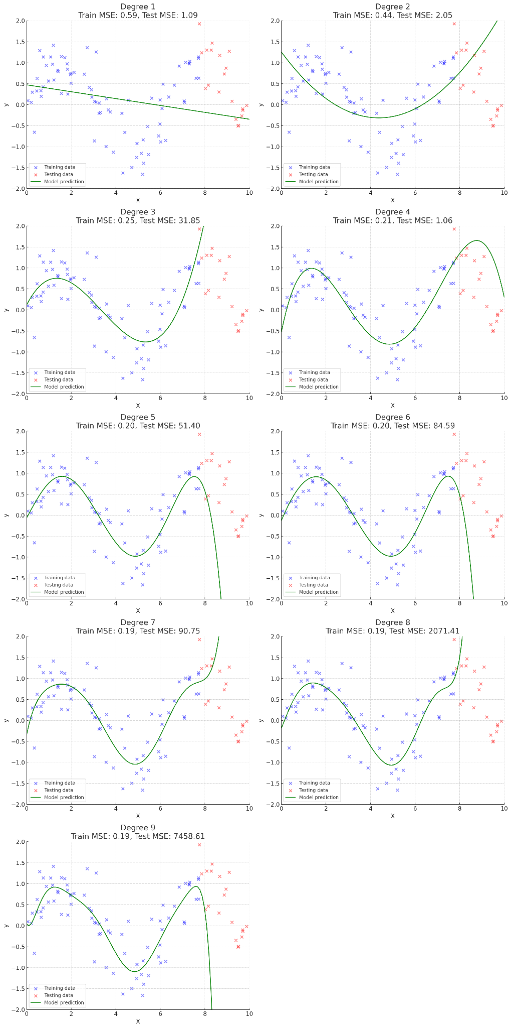
A theorem from analysis called the Stone-Weierstrass theorem states that any continuous function on a closed interval can be approximated by a polynomial.
You can think of the continuous function as the price action of the asset, and the approximating polynomial as the trading strategy. A more complex polynomial will better approximate a given function, but it also reduces the likelihood that the polynomial will also accurately approximate another random function.

Slide 17
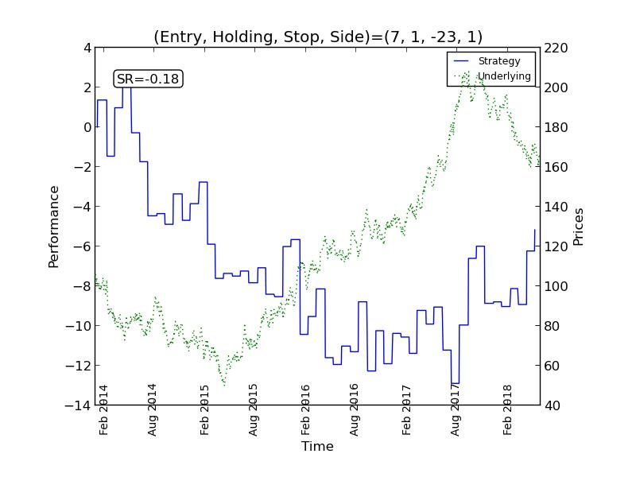
To illustrate that point, look at how the same strategy performs on the same asset over a different time period.
To continue the analogy, the new price action is a completely different function (despite the asset being the same). However, we haven’t changed our approximating polynomial, and so our polynomial fails to approximate the function.
This manifests as a very volatile period of negative returns for the trading strategy in blue.
Notes:
Ethan

Slide 18
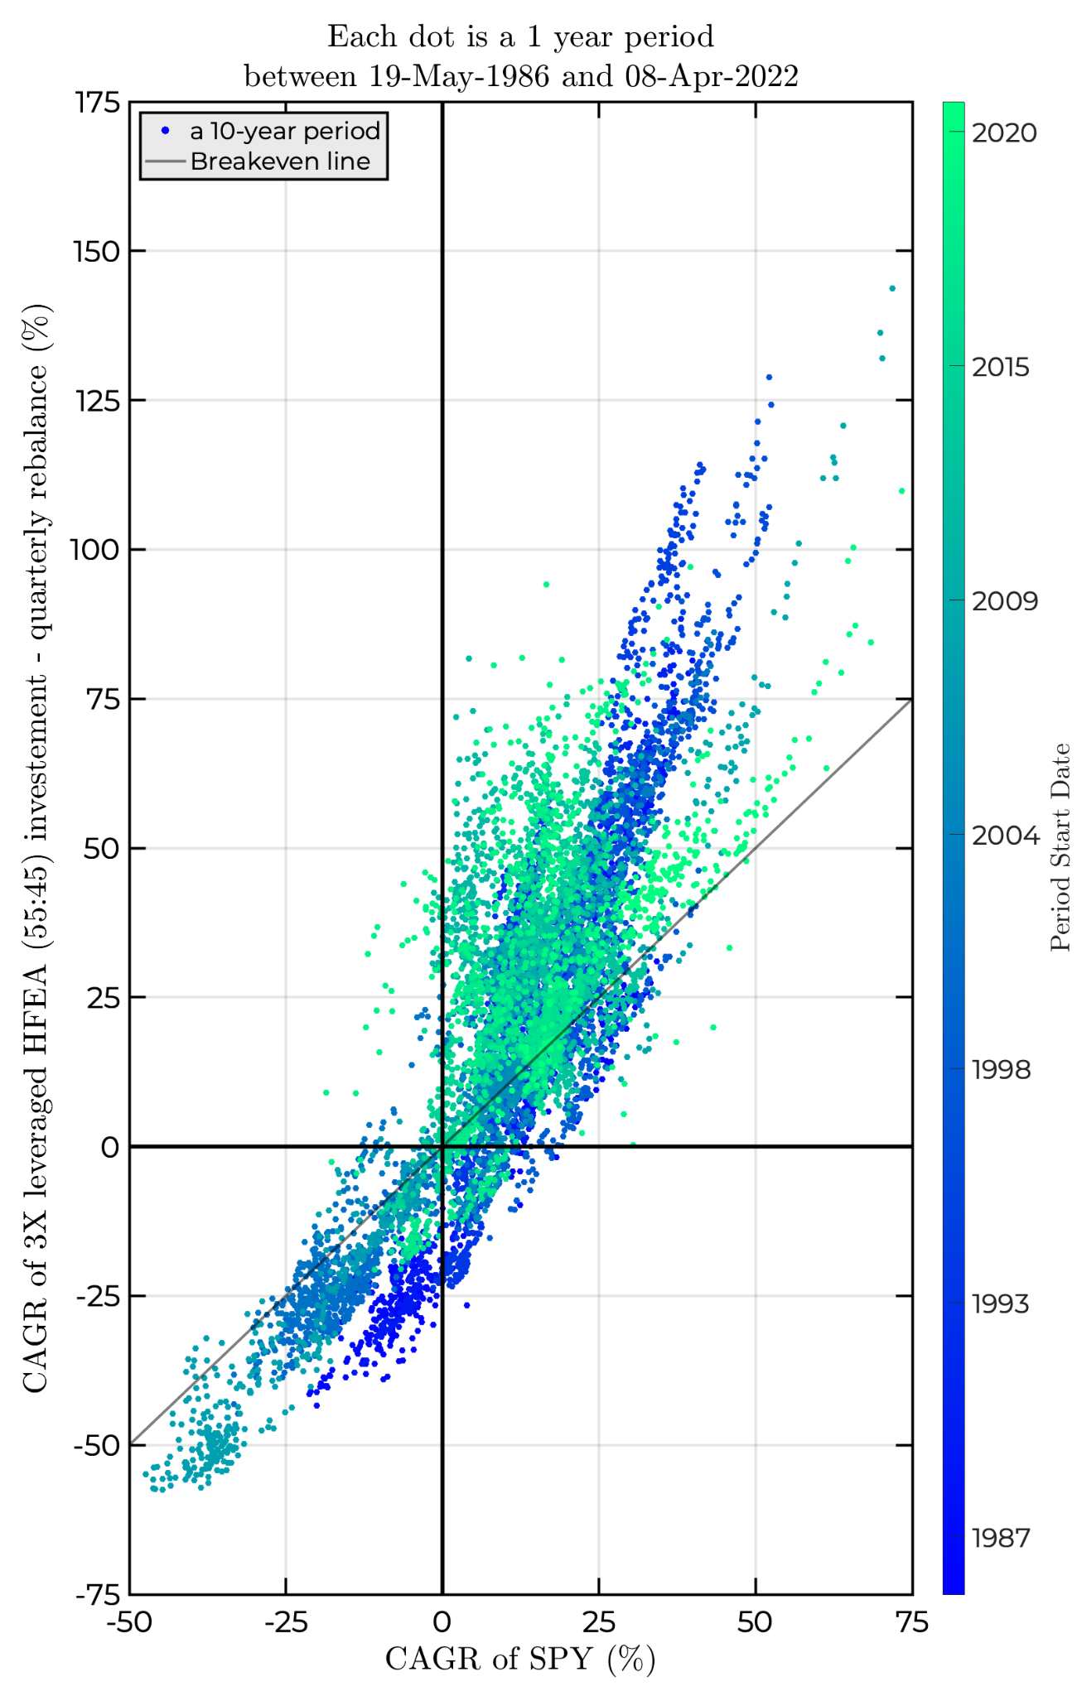
The Dos of Backtesting
Notes:
Ray

Slide 19
Proper Use of Data
As we saw in the example, testing a strategy on only one time period or sequence of underlying movements turns a backtest into a referendum on whether the strategy could have survived that time period or sequence.
For example, a backtest on only the past 5 years means the backtest is only a referendum on whether the strategy could have survived the pandemic crash.
This is an issue that heatmaps and other non-traditional backtesting plots can solve. One application of this is to plot all possible 1-year subintervals of a 10-year interval, for example.
Not only does this give you more data and market regimes to test on, it can also help with weeding out strategies that outperform due to a lucky start.
This is why we train-test-split, apply regularization, cross-validate, etc. in machine learning
Notes:
Ethan

Slide 20
A Case Study: 55/45 stocks/bonds, with a twist
A common investing strategy for passive investors is to dedicate some percentage of their portfolio to broad-market index funds and the rest to short or long term treasuries.
Younger investors are expected to lean more towards stocks to make the portfolio more aggressive and boost returns.
However, to reduce the volatility of returns, the bond allocation is increased to 45% in this strategy.
This greatly reduces returns, however. It effectively guarantees that our strategy will underperform the market over any meaningful period.
To remedy this, 3x leverage is added to both the stocks and bonds, either through the use of margin or shares of a leveraged fund.
The thesis is that the 165% exposure to stocks will fuel an outperformance of the market (100% stocks) without introducing unacceptable risk or volatility (due to the stock/bond ratio being the same, and the two classes being uncorrelated with each other).
How would we test this thesis?
Notes:
Ray

Slide 21
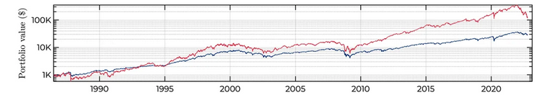
Simple Backtests
The red line is the strategy, the blue line is the S&P 500. Our strategy returned 14% a year from 1986 to 2023, while the market only returned 9.6% a year.
Notes:
Ray

Slide 22
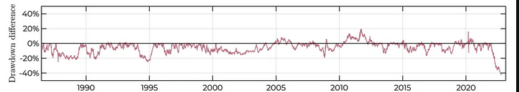
Simple Backtests
Additionally, the greatly increased returns only came with slightly elevated volatility
Notes:
Ray

Slide 23

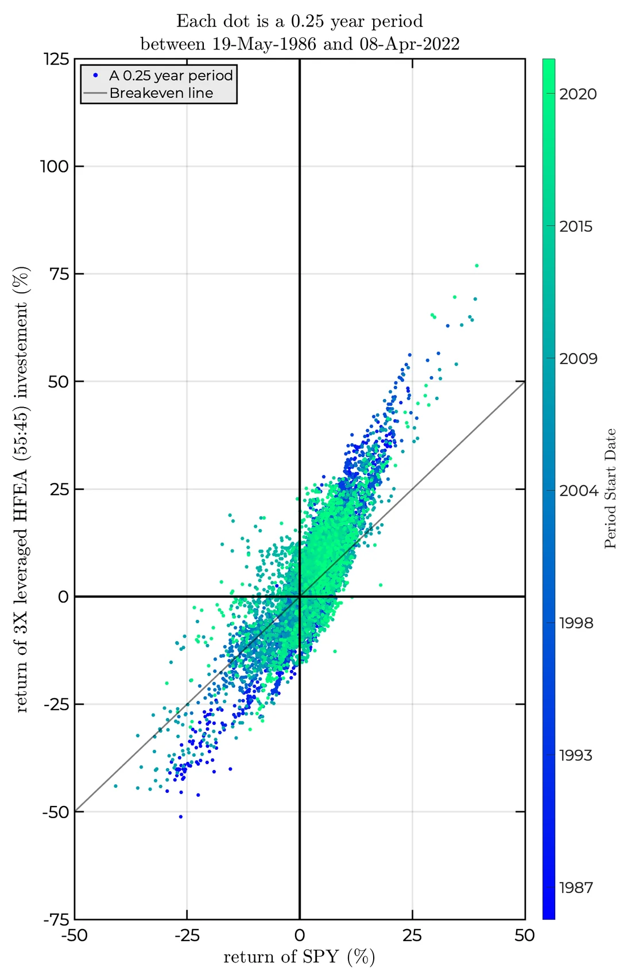
More Involved Backtests
The two plots test the strategy against the benchmark over roughly the same time period (1986-2022), but in a more comprehensive manner. Each dot represents a 1 year (left) or 3 month (right) sub-interval of the time period. The color of the dot represents when the sub-interval fits in the larger interval (bluer = earlier, greener = later). The x coordinates of the dots represent the return of the benchmark over the sub-interval, and the y coords represent the return of the strategy. Dots above the black line represent overperformance, dots under represent underperformance.
Notes:
Ray

Slide 24
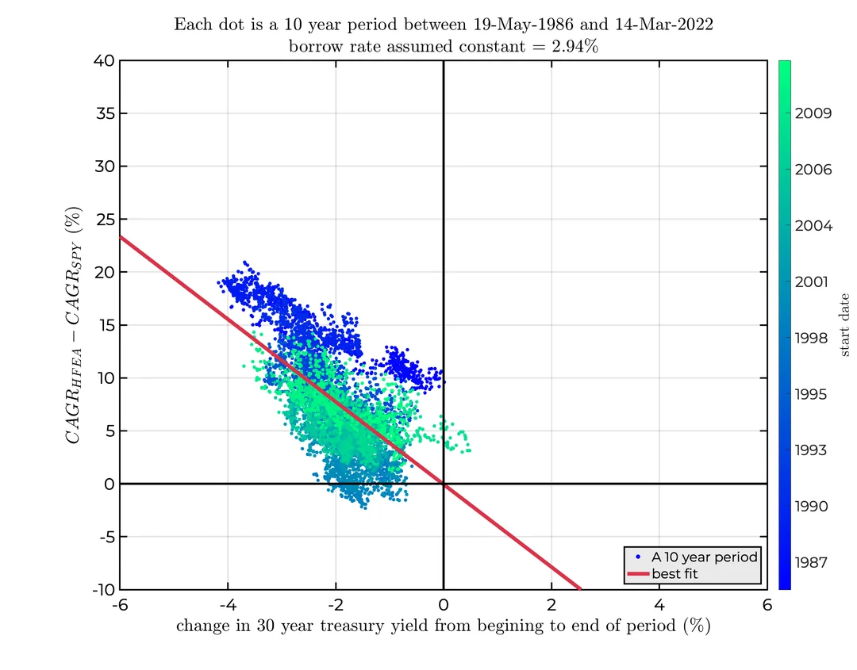
It’s important to remember that the strategy’s returns aren’t just a function of market returns, but also of the returns of the bond fund, which is itself a function of many factors including the treasury yield. Similar to last slide, each dot is a 10 year period between 1986 and 2022, with color representing age. The x-axis represents the change in 30-year treasury yield over the period, while the y axis represents the amount of overperformance of our strategy over the period. As we can see, falling bond yields are a significant driver of outperformance.
Notes:
Ray

Slide 25
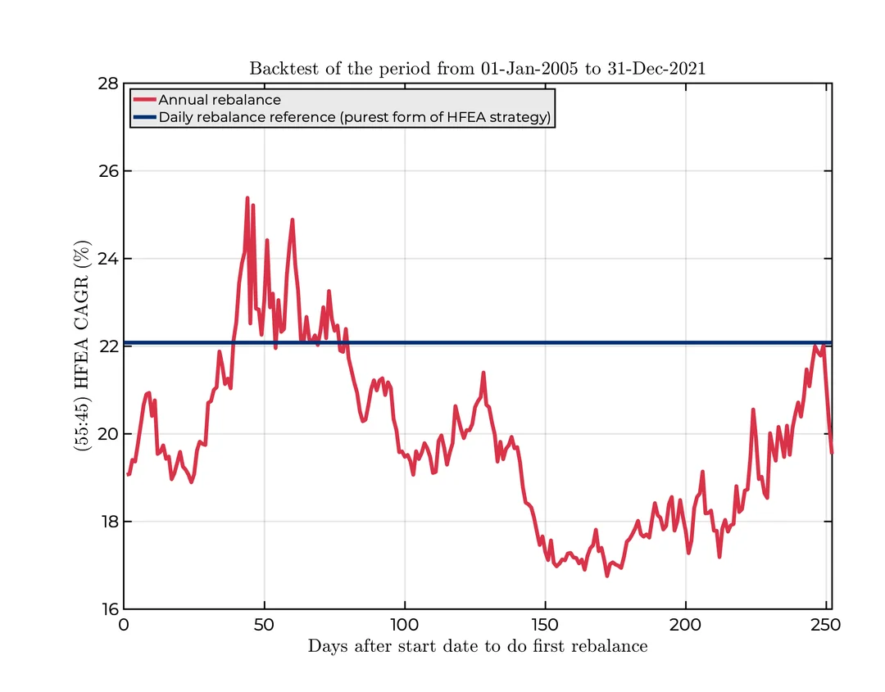
To keep a constant ratio of stocks to bonds, rebalancing is required (unless the assets move completely in tandem, which would defeat the purpose of the strategy). The more you rebalance, the less dependent the strategy’s returns will be based on the conditions of the rebalancing period. This is illustrated by the chart at the left – the blue line represents the yearly return if you were to rebalance daily. This would be the “purest” form of the strategy, but is impractical for most people. The red line represents the yearly return if the portfolio is rebalanced once a year, where the x axis represents the number of days you wait before rebalancing the first time. The delta between the highest and lowest values represents the amount that rebalancing “luck” affects the return.
Notes:
Ray

Slide 26
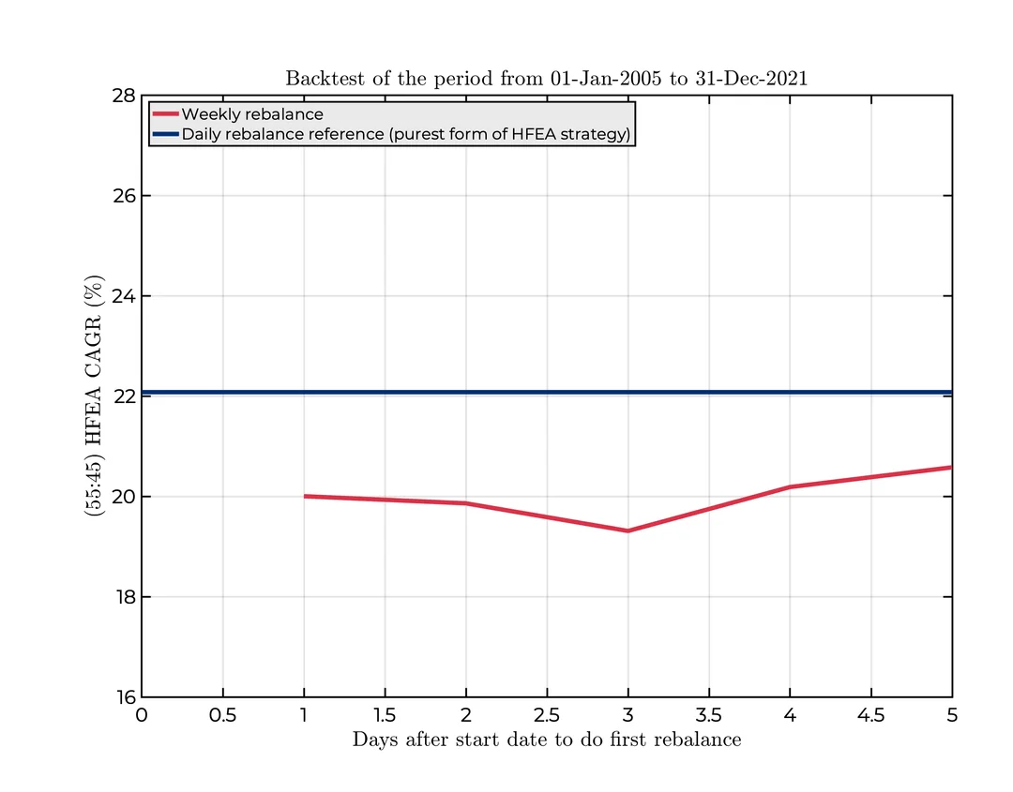
To further drive home the point – the chart on the right is for weekly rebalancing. As we can see, the difference between the high and low of the red line is much smaller than on the last slide, showing that the more you rebalance, the less rebalancing-induced variance can be expected in the strategy’s performance.
Notes:
Ray

Slide 27
In conclusion:
The strategy in question has historically performed well compared to the broad market indices
The strategy is sensitive to both broad market returns and long-term Treasury yields
The backtests do not “prove” that the strategy will perform well in the future, or even that it is likely to. They do show that the strategy is sensitive to both broad market returns and long-term Treasury yields, and critical points for overperformance can be found for both parameters.
Notes:
Ray
https://www.reddit.com/user/modern_football/

Slide 28
Vertical Integration
Notes:
Ray

Slide 29
The Development Vertical
Quant developers, in general, develop software tools to facilitate research and trading. Examples include low-latency trading systems and data visualization software.
The Development vertical at CWRU Quants will work on a comprehensive backtesting framework that the Research and Trading verticals will use (responsibly!) to backtest their strategies.
We will look to frameworks such as qstrader (https://github.com/mhallsmoore/qstrader/) and bt (https://pmorissette.github.io/bt/) for inspiration.
Experience in Python, competence with the popular data packages, and knowledge of basic financial mathematics would help in completing tasks related to this project.
Notes:
Ray

Slide 30
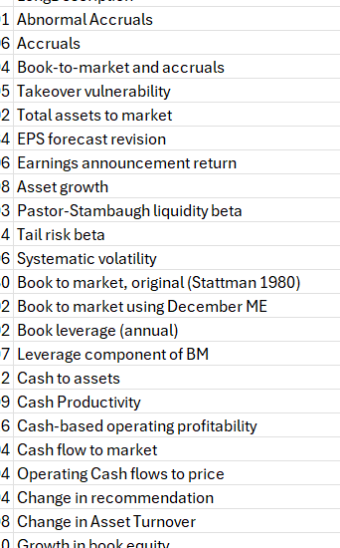
The Trading Vertical
Our goal will be to develop (profitable!) strategies
We have 212 already-established predictive signals
We also have the monthly returns, volume, shares outstanding, etc. of many stocks
Together, we will investigate what signals are the most effective (and in which industries too)
We will construct a strategy (portfolio?) based on this
Python will be helpful for the implementation and analysis (ML?)
SQL might be useful for querying (since these are large datasets)
Some financial background will be helpful for understanding the signals
Notes:
Christo

Slide 31
The Research Vertical
We will develop and test quantitative test strategies using data-driven insights. Some very common examples of this are momentum, mean reversion, and factor modeling.
Using Python to refine models and algorithms on our data according to various signals (that we will also be developing).
A lot of this is research based, which means reading papers, understanding them, and implementing them.
Developing proprietary signals (ideas!)
LinkedIn/X/TikTok scraping of company management
Alternative data
Notes:
Ethan
I think you guys should also look to develop some proprietary signals (to compare how good the ones we make are against the ones in the paper)
This can be a large portion if you need to be^
For example, scrape the linkedin posts of company management to get some signal
Or…get some sources of alternative data (like company management private jet logs) and see if there is any relation to company disclosures, stock price, etc.

Slide 32
QUESTIONS AND ANSWERS
Contact us!
Email: quants@case.edu
Instagram: @cwruquants

